Slide 1
Common application framework
Angular 4 Seed Walkthrough

Slide 2
Why are we doing this?
Today
Angular 4 Common Application Framework
UX Consistency
UX Design Inconsistencies
100% DSS/DHS Standard UX Design
Deployment
Inflexible Deploy Options (client + server = 1 repo)
Separate Unit of Deployment from Development
Platform
Older Platforms(MVC, Angular1)
Well-supported, Rapidly growing Platform (Angular 4+)
Latency
Long Start-Up Latency
Instant-On Low Latency
Performance
Performance Issues due to Chattiness, Large Payloads
High Performance: Fewer AJAX calls, Smaller Payloads
Reusability
Reuse primarily via Copy/Paste
Component-Bases Reuse
Code length
1000s of lines of code
100s of lines of code
Linting
Inconsistent Code quality, Formatting
Linting Built-In
Automated Testing
No Automated Tests
Fully Automated Acceptance/Unit Tests
Production Deployment
Challenges
Deployment Simplified, Automated, CI/CD Built-In
Production Debugging
Challenges
Rich State Debugging Tools: Augury, Redux Dev Tools
Testing frameworks are included out of the box.
Protractor uses Selenium Server to output feature testing logs.

Slide 3
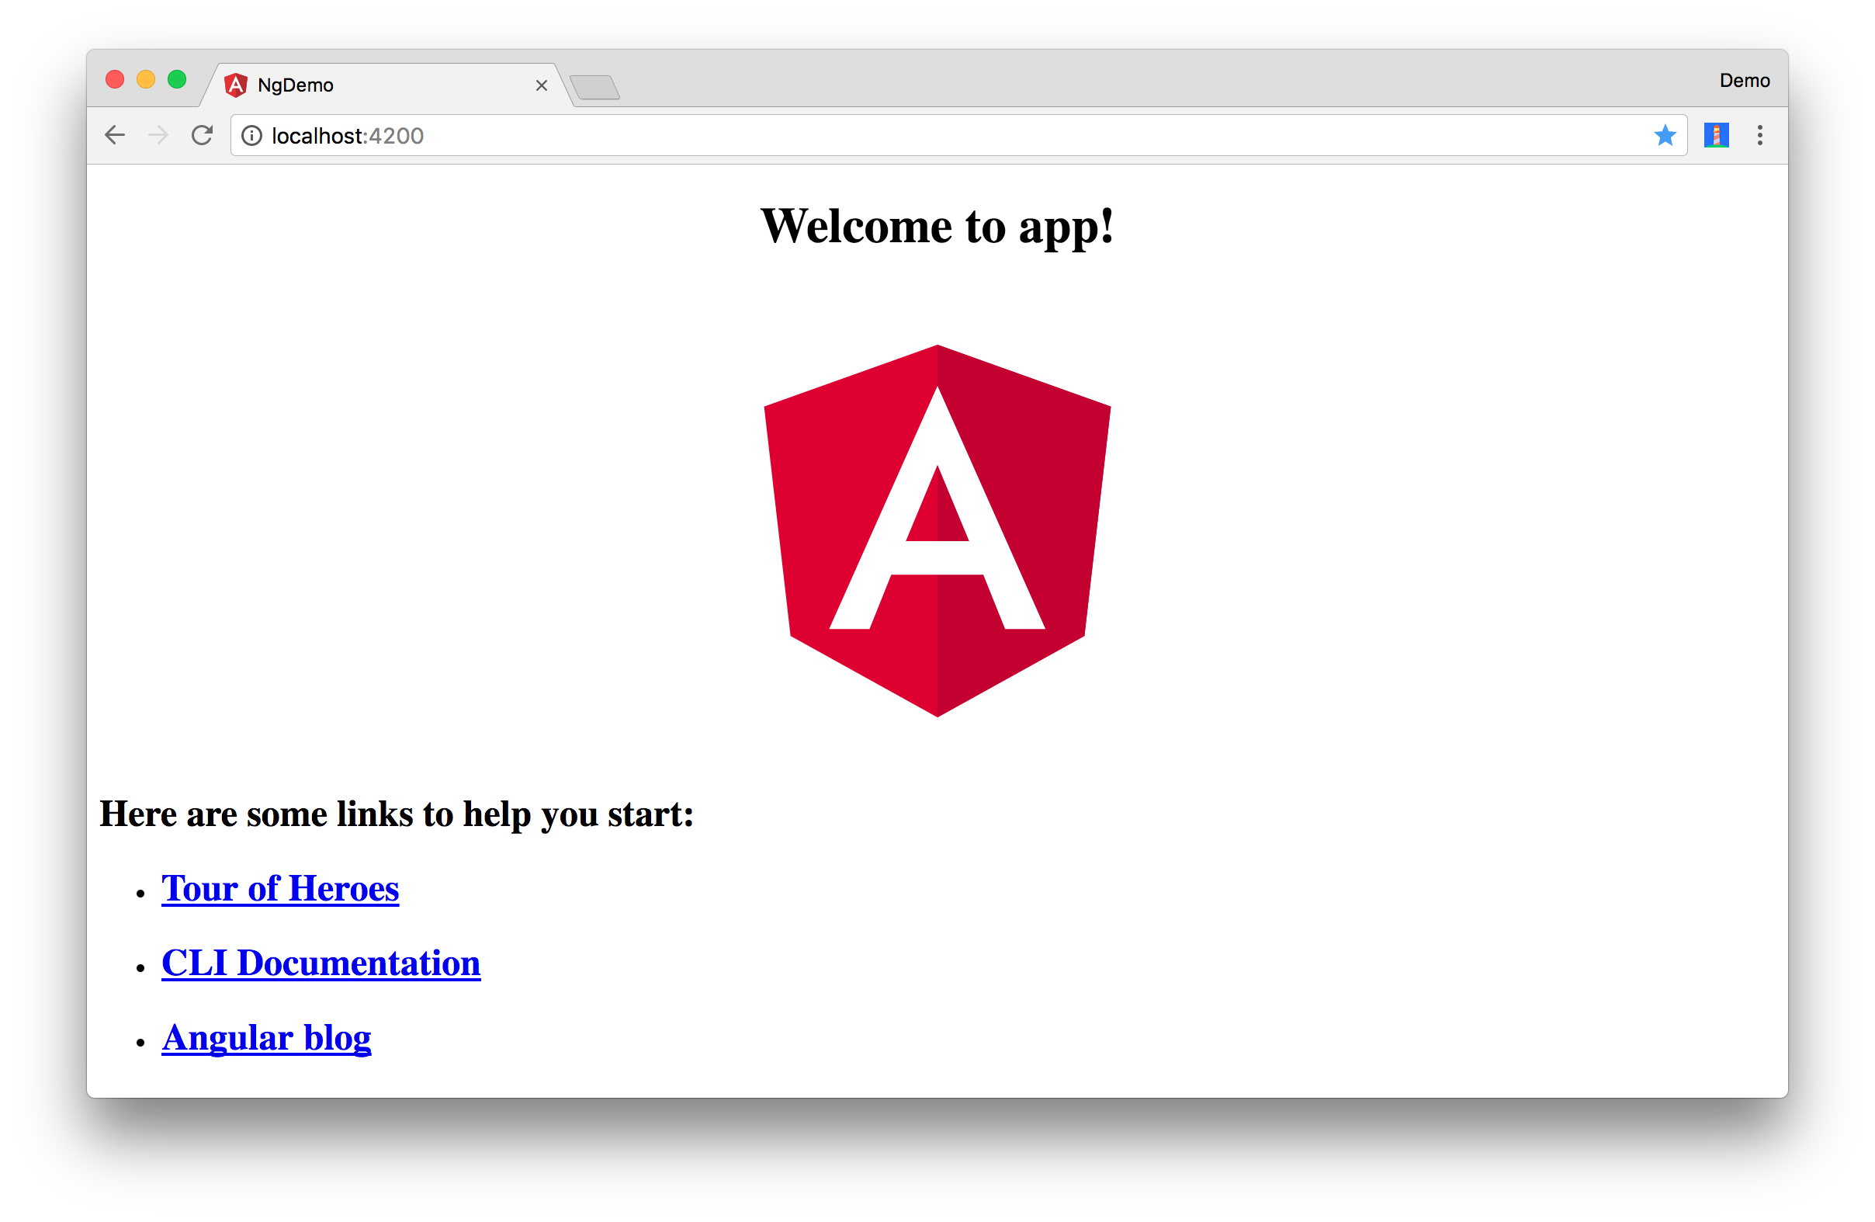
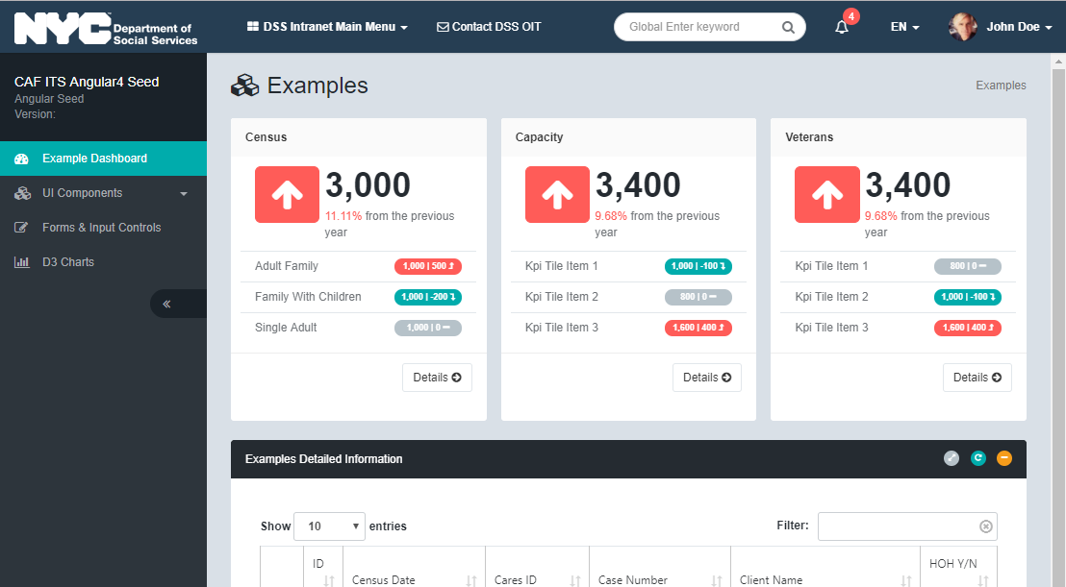

How CAF Builds On Angular4(CLI)
Angular 4 Application created with Angular CLI
CAF Angular Client built with CAF Angular CLI
npm install –g @angular/cli
ng new my-app
cd my-app
npm install
ng serve --open
npm install –g @angular/cli
npm install –g https://bitbucket.org/dhsit/caf-angular-cli
caf new my-app
cd my-app
npm start

Slide 4
How CAF Builds on Angular 4(Architecture)
CAF Angular CLI
Angular 4 Application
Add routes
AppRoutes
Unit Test
AppModule
Dependencies
update
dependencies
Component
Add examples(KPI, grid)
Dependencies
E2E Test
Template
Mock Backend
Store
Stylesheet
Setup mock backend
API server
configure
redux
Import stylesheet
Import modules
Redux Store
CAF Angular Client
AppRoutes
Redux Store
CucumberJS
Core Dependencies
CAF STYLES
JSON Server
Header / Sidebar
CAF ANGULAR COMMON
Package.json
Examples

Slide 5
How CAF Builds on Angular 4(Common Modules)
Base Angular 4 Application
CAF Angular Common Modules
CAF Angular Common Modules
AppRoutes
AppModule
AJAX
Navigation
Form & Input
Utils
Component
Item
List
Dynamic Input
CasePipe
Dependencies
Template
List
Menu
Text Input
HighlightPipe
Store
Stylesheet
Lazy load
Sidebar
Select / Options
KiloPipe
Charts/Graphs
Indicators & Icons
Radio button
ResizeService
Checkbox
Spinner
CAF Angular Client
Pie
Badge
Donut
Icon
Datepicker
Notifications
Redux Store
Core Dependencies
Stacked Area
KPI
Range Slider
Notification
CAF STYLES
Authentication
Data Grid
Panels & Overlays
Alert
Header / Sidebar
CAF ANGULAR COMMON
AuthGuard
Panel
Examples
Error Handler
Login
Modal

Slide 6










Environment Comparison
Language
CLI tool
Unit Testing
E2E Testing
Angular 1.x
X
Supported but
not out of the box
Supported but
not out of the box
Selenium
Angular 2 +
Web driver
+
+
(Angular CLI)
Istanbul
Test coverage
Avoid painful common bugs by type-checking the code.
Reports issues without even saving file.
Leverage the type system to help you write code even faster.
Serve and build application for both prod/dev mode.
Run testing frameworks.
AOT and JIT compilation.
All modern frameworks now use CLI: dotnet.exe, rake, etc.
Testing frameworks are included out of the box.
Testing helper functions.
Additional plugins may be added in karma.config.js
Testing frameworks are included out of the box.
Protractor uses Selenium Server to output feature testing logs.
Cucumber is used for Automated Acceptance testing

Slide 7


Architecture Comparison
AngularJS(version 1)
Angular(version 2 +)
Module
View
Controller
event
binding
Directives
Components
Services
HTML
property
binding
Directives
request
response
CSS
Services
Injection
WEB API
two-way
binding
updates
model
request
response
Component
Models
WEB API
event
binding
property
binding
Template
HTML
LESS
The architecture of Angular 1 is based on the Model View Controller.
Angular 2 is based on a Component structure, like what we see in React.js.

Slide 8



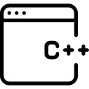






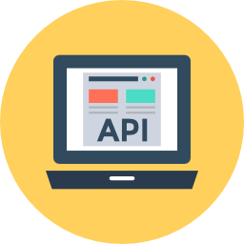




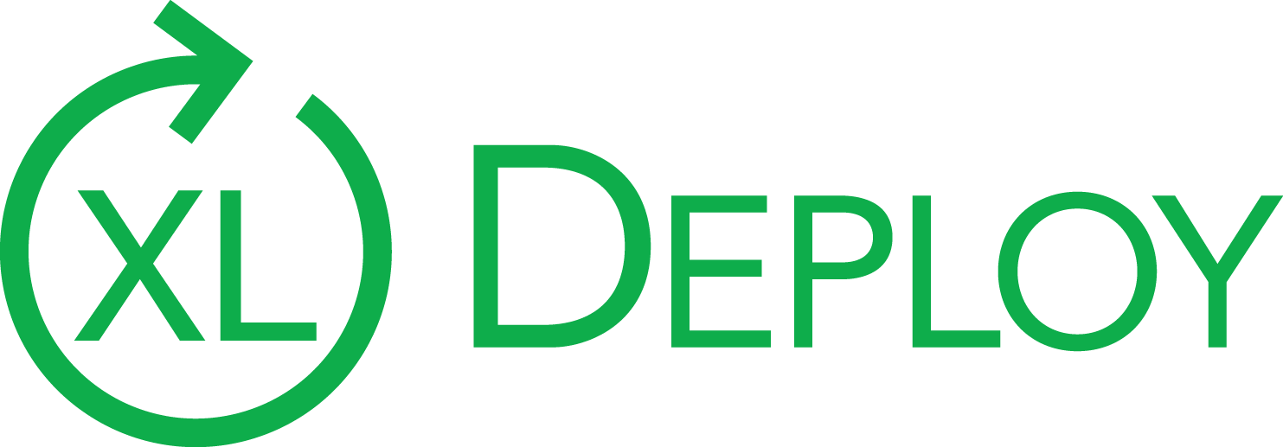

Git Submodules Separate Unit of Dev from Unit of Deployment
DEV Server
Supports flexible development and deployment scenarios Easily add new submodule to a parent project repo Reuse submodules in multiple projects (e.g. surveys)
Swagger documents the web-services API
Postman for Client-less Server-Side Testing
JSON-Server for Server-less Client Testing
Kestrel
#
Postgres
Mobile
Submodule
Mobile
Submodule
build
trigger
Mobile
Developer
Client
Submodule
Client
Submodule
build
trigger
Server
Submodule
Server
Full-Stack
Developer
Server
Submodule
build
trigger
Parent project-repo combines git submodules
Into a unit of deployment
Client
Submodule
JSON
Server
Front-end
Developer
JSON-Server
Lightning-Fast Server-less Development
Cucumber/Selenium Acceptance Tests
Example payloads for Swagger API documentation
Pipelines
Continuous Delivery
Any change to ANY submodule triggers automated deployment

Slide 9


TLDR; So.. How Do I Get Started?
Migrate from Monolithic to Micro Services Architecture
START
Angular 1 or ASP.NET WebForms
.NET 4.5.1
FINISH
CAF/Angular 4
CAF/.NET Core 2
Create Project Container
repository
Monolithic repository
Project container repository
{{ application name }}
{{ application name }}
Update
Client submodule
{{ application name }}
Install CAF Angular Client
Client submodule
repository
Create Client submodule
repository
Client-side code
{{ application name }}-client
{{ application name }}-client
Update
Server submodule
Develop .NET Core WEB API
services
Server-submodule
repository
Server-side code
Create Server-submodule
repository
{{ application name }}-server
{{ application name }}-server
Step 1.
Create separate repositories for each container, client, server
Step 2.
Update client-side with CAF angular client, and server-side with .NET core WEB API services.
Step 3:
Add client & server repository as submodules of project container using ‘git submodule’ command
Git submodule documentation

Slide 10
Key CAF Features
Sample usage of CAF Angular Common
Production and Development builds
Hot module reload
State management using Redux
Sample unit test with Jasmine and Karma
Sample end-to-end test using Cucumber
Continuous integration using Bitbucket Pipelines

Slide 11
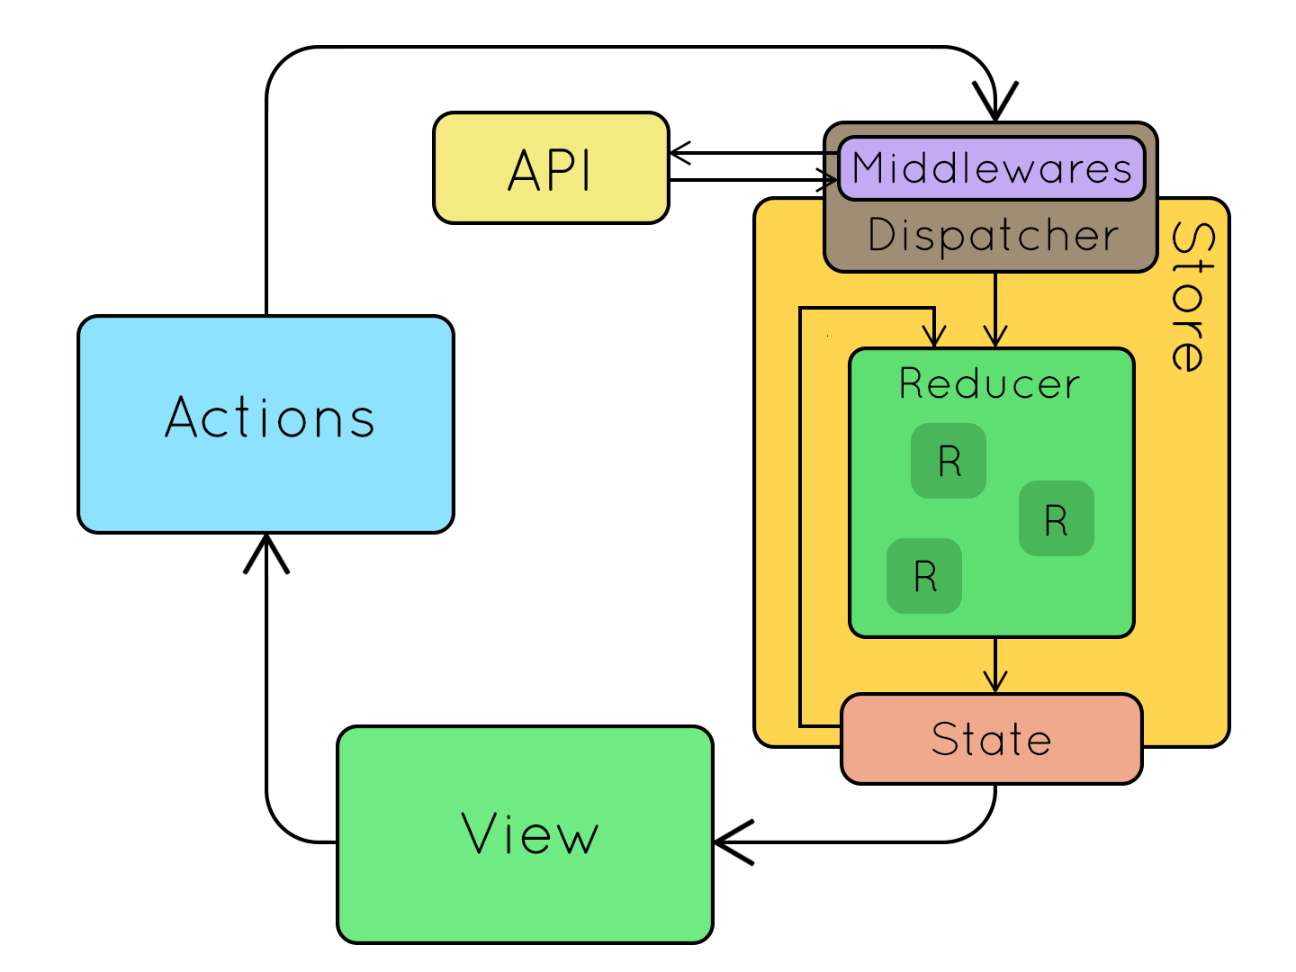
Benefits of Redux Approach to State Management
Why is Redux worth learning?
Performance JSON data cached in store, no need to re-retrieve on user navigation
Maintainability All state centralized, keeps code neat and clean
Testability Significantly simplified unit testing
Flexibility Can set eviction policies to decide when to flush cache (c.f. redux-cache)
Enables Powerful Use Cases Centralized error handling, Recreate production scenario via export-import state

Slide 12
Angular 4 Component Structure
Component Render Example
app works
Component(Typescript)
Template(HTML)
Style(LESS)
import {Component, OnInit} from '@angular/core'; @Component({ selector: ‘app-root', templateUrl: './app.component.html', styleUrls: ['./app.component.less'] }) export class AppComponent { title = app works!'; }
<div>{{title}}</div>
:host > div {
background: ‘red’;
color: ‘white’;
padding: 10px;
}

Slide 13

Seed Application Architecture
Modules(Controllers)
Redux Store
Components
Directives
State
renders view
Reducers
Views
Actions
Testing
Components
Containers
Unit Testing
E2E Testing
Core Libraries
AJAX
CAF ANGULAR COMMON
(Angular 4 common module library)
CAF STYLES
(NYC ITS standard UI/UX design styles)
request
response
Only JSON Is Passed Back and Forth ➨
Smaller, Faster than traditional ASP.NET
JSON SERVER

Slide 14
Common application framework
DEMO

Slide 15
Repository Links
CAF ANGULAR CLIENT
(Angular 4 seed project)
https://bitbucket.org/dhsit/caf-angular-client
CAF ANGULAR CLI
(Angular 4 seed generator)
https://bitbucket.org/dhsit/caf-angular-cli
CAF ANGULAR COMMON
(Angular 4 common module library)
https://bitbucket.org/dhsit/caf-angular-common
CAF STYLES
(NYC ITS standard UI/UX design styles)
https://bitbucket.org/dhsit/caf-styles

Slide 16
Links to Resources
Categories | Title and URL | Publisher | Size | Price
.NET Core Angular5 | Build an app with ASPNET Core and Angular from scratch A Practical example of how to build an application with ASP.NET Core WebAPI (v2) and Angular (v5) from start to finish | Udemy | 20.5hr video | $10
Automated Testing | Writing Great Specifications: Using Specification By Example and Gherkin An example-rich tutorial that teaches you how to write good Gherkin specification documents that take advantage of the benefits of specification by example– for Automated Acceptance Tests | Amazon or Manning | 400 pages | $36.81
Angular4 | Angular 4 (formerly Angular 2) - The Complete Guide Master Angular (both Angular 4 and Angular 2) and build awesome, reactive web apps with the successor of Angular.js | Udemy | 22hr video 17 articles 73 resources | $192 ($10 after discount)
Redux Angular4 | Redux in Angular (2 and 4+) Better manage the state of your Angular apps, improve their testability and use awesome debugging tools | Udemy | 1.5hr video | $70 ($10 after discount)
Angular1 → Angular2 | Upgrade Angular 1 app to Ang4 in 5 simple steps | Online | 10 pages | FREE
Protractor & CucumberJS | Tutorial: Creating maintainable E2E tests with Protractor and Cucumber | Medium |  | FREE
Redux Observable | Understanding RxJS and Redux-Observable | Medium |  | FREE

Slide 17
Links to Library Source
Title and URL | Description
Angular 5 | Front-end MVC Framework
Redux | State container for javascript
Redux Observable | Redux middleware with RxJS Observable
Angular CLI | CLI tool for Angular
Angular Redux | Redux store implementation in Angular
Typescript | Language
RXjs | The ReactiveX library for JavaScript
Protractor | Protractor is an end-to-end test framework for Angular
Jasmine | Unit testing framework
JSON-server | Mock-backend for CAF

Slide 18
Next Steps
Bootstrap v3 to 4 Upgrade
Risks: High
Benefits: High
Effort: Very Large
Requires migration from LESS to SCSS. Entire UX catalog
must be migrated. Significant CAF Component
Refactoring. Much better horizontal fitting for tables
Angular v4 to 5 Upgrade
Risks: Low
Benefits: Moderate
Effort: Small
Angular5 incorporates Angular Universal for optional
server-side rendering, and performance improvements. Very few API changes
Additional Components
Risks: Low
Benefits: High
Effort: Moderate
We are adding in-cell editing for tables, login integration with Active Directory and form input controls supporting template driven forms and reactive forms as well as a global error handling service
Immediate
Now
Short-term
Feb
Long-term
TBD

